Slide 1

CS50P Final Project
Project title: TSS calculator
Miha Hrovat, 2025

Slide 2
Video requirements
Project title: TSS calculator
Name: Miha Hrovat
GitHub and edX usernames: Miketymike (GitHub), mihahrovat (edX)
City and country: Prague, Czech Republic
Date of recording: 19.02.2025

Slide 3
Project background
Zwift is a massively multiplayer online cycling and running physical training program that enables users to interact, train, and compete in a virtual world
One of the races I do with my team is TTT (team time trial), where we each do a part of the work on the front, while the rest is drafting behind
When we plan for the race, we try to optimize the workload between the team of (ideally) 8 riders (max. team size)
Workload is measured by TSS (training stress score)

Slide 4
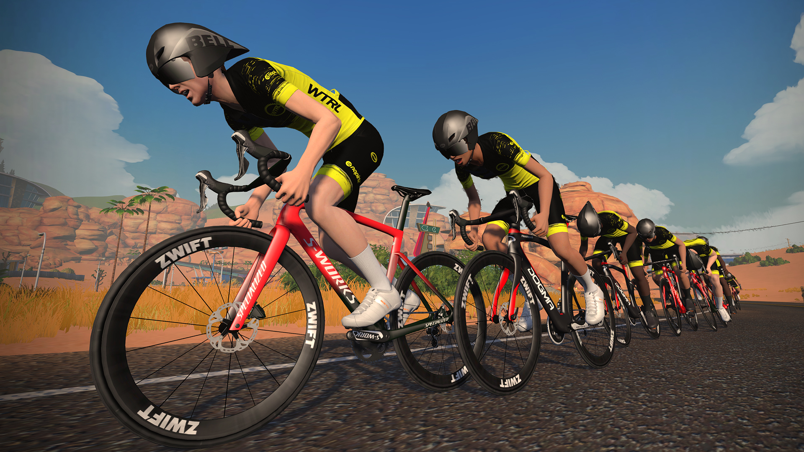

Slide 5
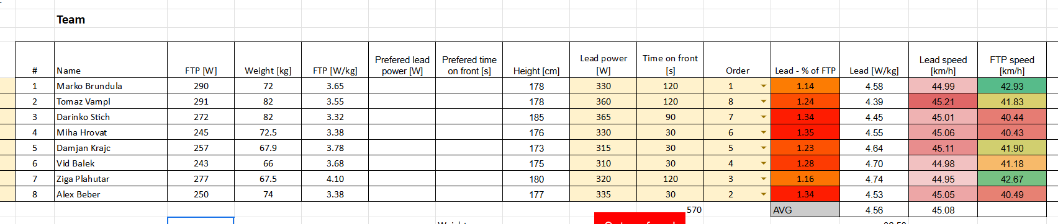
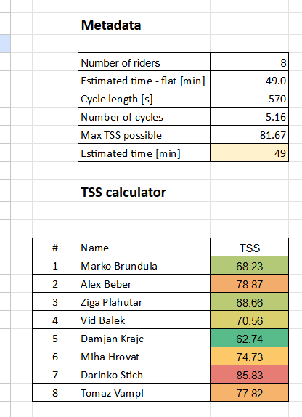
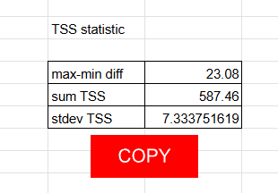
We use Google Sheets for some calculations, but don‘t have a calculator to distribute the workload „as fair as possible“ (TSS being as small as possible between min. & max.)

Slide 6
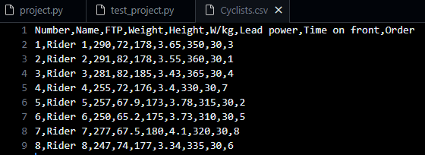
What the program does?
It takes .csv file copied from the planned Google Sheets table in this form:
Not all the columns are needed for this project, but could be used to further improve the calculations based on the game‘s algorithm

Slide 7
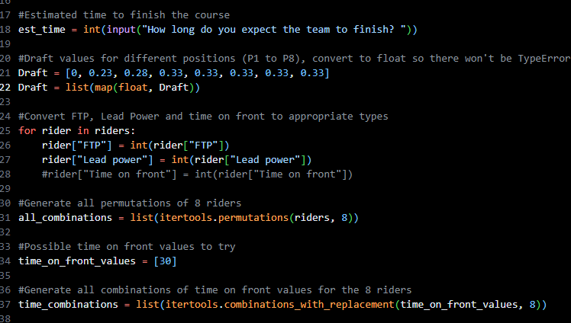
It takes the input of the user on the estimation of time the team will take to finish the course
It does some converting for calculations further down the line
It creates 40320 permutations for 8 riders to get all possible versions of order
It takes all possible combinations of times for each rider (for purposes of this project and shorter calculation times, I only chose 30s for each rider, otherwise we are chosing from 30, 45, 60, 90 and 120 seconds which would enormously increase the number of possible combinations and calculation time)

Slide 8
In this project‘s example, it then creates 40.320 combinations of riders and for each combination applies 30s for each rider
It then calculates multiple metrics required to get to the final desired TSS difference result:
Summary of all lead times (in this case 8x 30s = 240s), cycles per course (sum(lead times) / estimated minutes to finish, in case of 30min, this is 7.5 cycles), rider‘s position in current iteration, power at each of 8 positions, time at each of 8 positions, NP (normalized power) and TSS, and lastly, TSS difference (max. – min.) for current iteration
Lastly, it outputs a sorted .csv file with results of all the iterations that have TSS_diff smaller than the one input by the user

Slide 9
